Slide 1
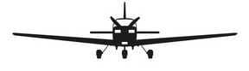






$$Y_{b}$$
$$Z_{b}$$
$$ϕ$$
$$ϕ$$
$${X_{i}Y}_{i}$$
$$Z_{i}$$

